Slide 1
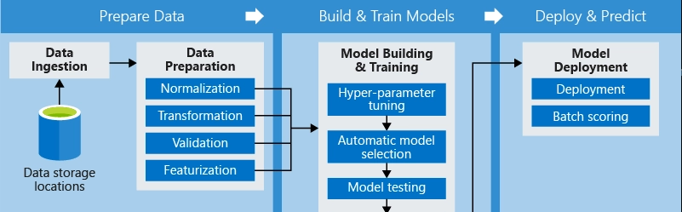
The ML Pipeline & Data Preparation
Getting Real-World Data Ready for the Algorithm
Instructor: Zaryab Ahmad Khan

Slide 2
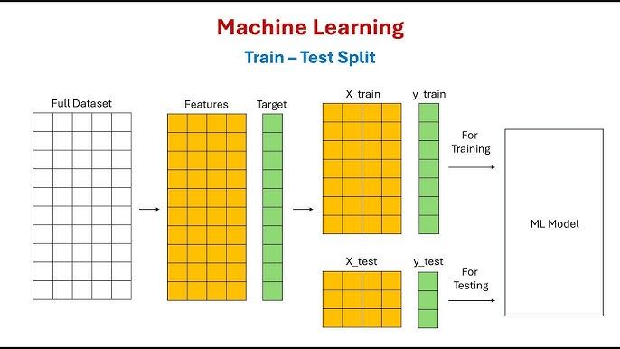
The Train / Test Split (The Golden Rule)
Concept: Never test the AI on the data it used to learn. It’s like giving a student the exact exam paper to study from—they will just memorize it, not learn the concepts.
The Standard Split:
80% Training Data: Used to teach the model.
20% Testing Data: Kept completely secret until the end to evaluate true performance.

Slide 3
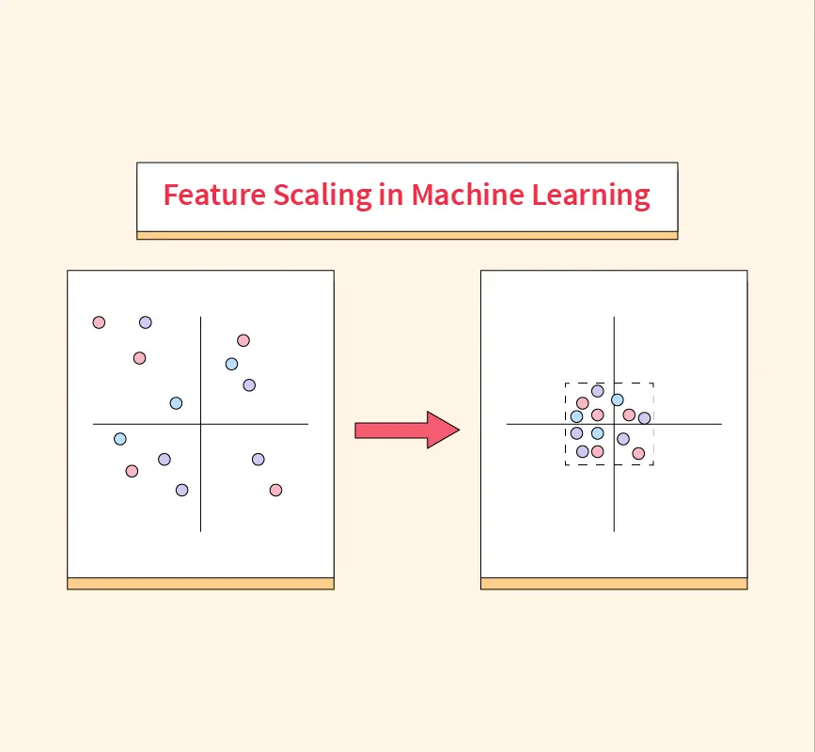
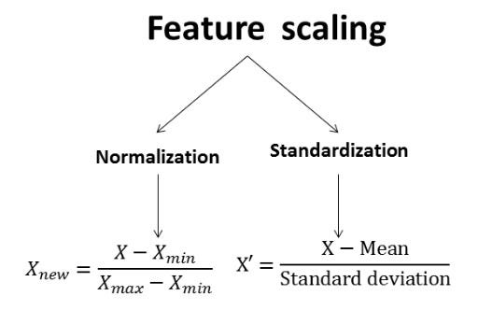
Feature Scaling (Leveling the Playing Field)
The Problem: Algorithms process numbers blindly. If your dataset has "Age" (ranging from 18 to 60) and "Salary" (ranging from 50,000 to 200,000), the AI might think "Salary" is mathematically more important just because the numbers are bigger.
The Solution: Standardization/Normalization. We shrink all columns down to a similar scale (e.g., between 0 and 1, or around a mean of 0) so the model treats every feature fairly.

Slide 4
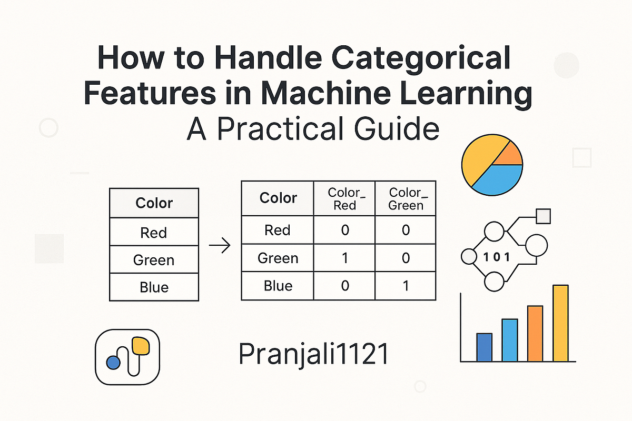
Handling Categorical Data (Translating Text)
The Problem: Machine Learning models are essentially complex math equations. You cannot multiply the word "Peshawar" by a weight.
The Solution:
Label Encoding: Converting text to simple numbers (e.g., Yes = 1, No = 0).
One-Hot Encoding: Creating new binary columns for categories (e.g., is_Peshawar, is_Mardan) to prevent the model from thinking Mardan (encoded as 2) is "twice as big" as Peshawar (encoded as 1).

